Slide 1
UNIVERSAL BATTERY PACK MECHNICAL DESIGN
Designed by August

Slide 2
How good can/should it be?
Truly Universal
Production friendly
Water proof (IP68, submerge test)
Modulated design
Low Impedance current path
High strength
Mountable to mobile equipment
Withstand strong vibration
Highly stackable
Low cost tooling
Capability for air cooling
Convertible to main control chamber
Easy shaping to meet customer space requirement
Strong handle
Small footprint
Rugged enough for industrial use
Yet, clean, slake, interconnection hidden, beautiful enough to put in living room

Slide 3
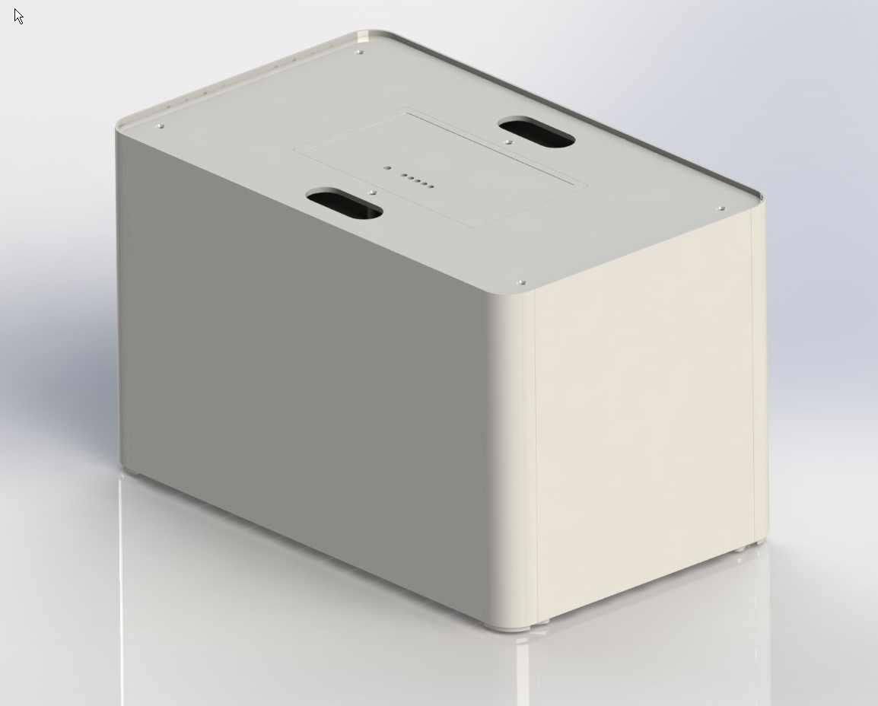
Ok enough! How it looks?

